Slide 1
Baker Hughes Activity Durations in EPC Projects

Slide 2
Intro to Baker Hughes

Slide 3

We take energy forward - making it cleaner, safer, and more efficient for people and the planet
120
Countries
68,000
Employees
$23.8B
Revenue
161
Perfect HSE days in 2019
$687M
In R&D development
2,700
Patents awarded
Notes:
Baker Hughes is an energy technology company that provides solutions for energy and industrial customers worldwide.
With operations in over 120 countries and more than 67,000 employees, we design, manufacture and deliver leading technology solutions for our customers. Powered by the industry’s only fullstream technology portfolio, and enabled by our people and scale, we drive productivity and improve outcomes for ourselves and our customers.
From the first rotary drill bit to the world’s most extensive portfolio of compressors and gas turbines, and from digital solutions that predict outcomes to modular deepwater technology, for more than a century our inventions have been revolutionizing the industry.
We are reducing the carbon intensity of our operations, applying proven low-carbon technology to help our customers meet their environmental goals, and innovating for the future of energy.
At Baker Hughes, we are taking energy forward – making it safer, cleaner and more efficient for people and the planet.

Slide 4

We are an energy technology company
Our innovative technologies are taking energy forward
Notes:
The global energy industry is changing. Experts predict that over the next 30 years demand for energy will continue to grow by as much as 30%. There will be higher demand for renewables and natural gas, but oil will remain a big piece of the energy mix, too.
Baker Hughes is Energy Technology Company. Our technology and service offerings uniquely position us for opportunities created by the energy transition. And by anticipating future energy trends, and leveraging our unique product mix of oilfield, turbomachinery and measurement, we can make make energy cleaner, safer and more efficient for people and the planet. We aspire to make Baker Hughes the provider of choice in the energy industry of the future.

Slide 5
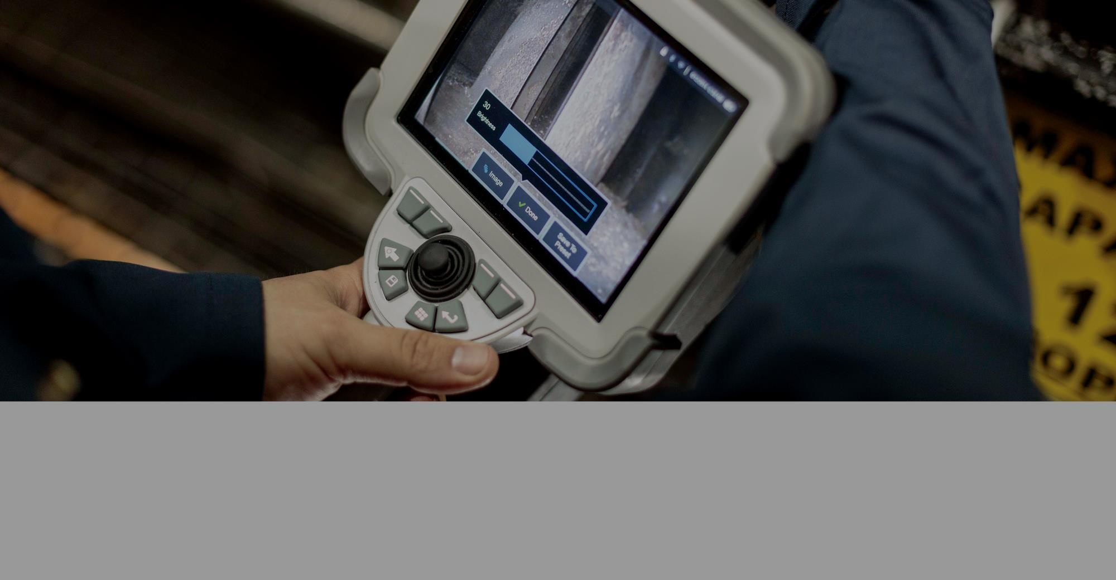
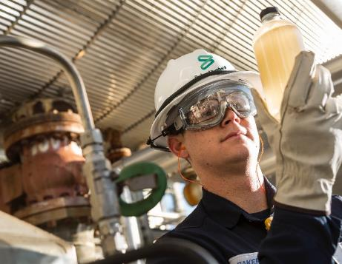
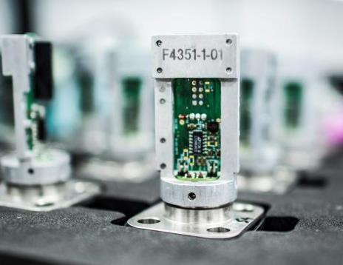
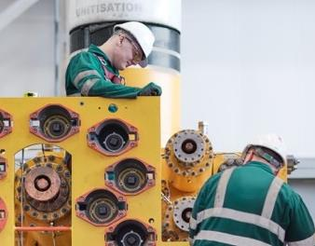
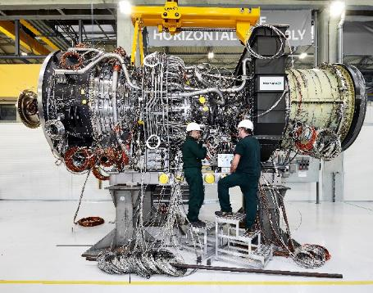

Our product companies
Oilfield Services
Lower cost per barrel over the life of field
Digital Solutions
Peace of mind for the world’s infrastructure
Oilfield Equipment
Ultra-reliable technologies for the harshest environments
Turbomachinery & Process Solutions
Industry-leading availability and reliability
OFE
Notes:
We operate with four product companies.
Our Oilfield Services (OFS) business lowers the cost per barrel of oil equivalent for the life of a well by improving well efficiency, optimizing production and increasing ultimate recovery.
Our Oilfield Equipment (OFE) business provides customers with a portfolio of ultra-reliable technologies, including subsea trees, manifolds, blowout preventers (BOPs), flexible risers and advanced control systems.
Our Turbomachinery & Process Solutions (TPS) portolio of rotating equipment, process flow, transmission technology and lifecycle services helps maximize productivity, enhance efficiency, minimize risk and optimize total cost of ownership across onshore-and-offshore production, gas processing, pipeline, liquefied natural gas (LNG), refining, petrochemical and industrial sectors.
Our Digital Solutions business We bring peace of mind to the world’s infrastructure. Their intelligent, connected technologies sense, monitor, control, and inspect your operations in real time.

Slide 6
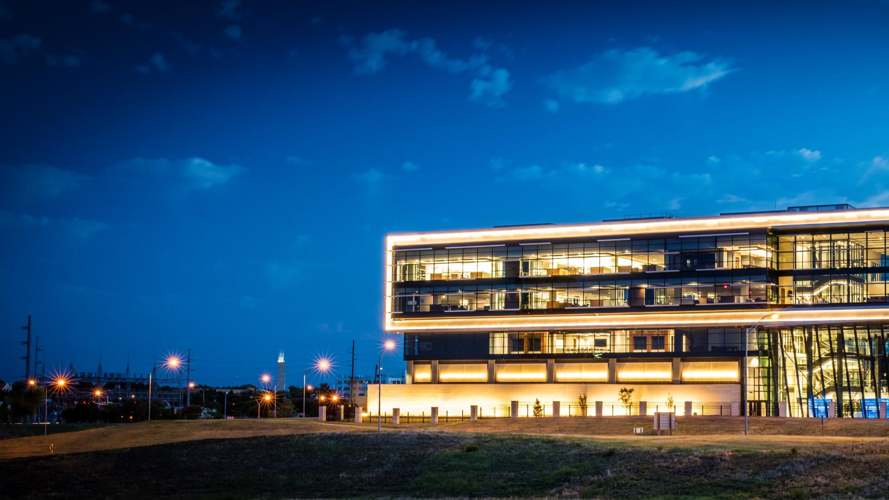
How we innovate
New technology and ventures
Industrial innovation
Digital innovation
9,000+ engineers and scientists
~$700M in research investment
17 global innovation centers
8 additive manufacturing centers
~2,700 patents issued in 2018
>100 new product launches in 2018
>10,000 additive parts since 2017
Notes:
Industrial and digital technology leadership is core to who we are. We apply engineering, science and data to redefine what’s possible. We put our entrepreneurial spirit and our history of innovation to work every day. Our original thinking and practical know-how drives our technological advantage and global capabilities.
With more than 2,700 patents, Baker Hughes holds the most oil & gas technology patents of any company globally. To date we’ve invested $700 million in research & development and introduced more than 100 new products.
Our innovation agenda is driven in four key areas:
Our innovators – Our global network of 9,000 engineers and scientists
Industrial innovation – Enhancing productivity for ourselves and our customers through streamlined manufacturing and supply chain
Digital innovation – Delivering enterprise-scale A.I. and intelligent automation across the value chain
New technology and ventures – We explore new ways to adapt, apply and iterate new technologies and accelerate them to the market through partnerships like Avitas and Nextstream

Slide 7


Digital transformation
Artificial intelligence and machine learning
Innovation at the industrial edge
Digital Solutions technologies
We extract the power of data to improve operational productivity, efficiency, and safety.
Notes:
We work to deliver enterprise-scale A.I. across the value chain and drive intelligent automation through the integration of emerging technologies. Our goal is to augment the way we interact with data and machinery at the source of the operation to enable customers to make quick, accurate and predictive solutions.
Our digital strategy is based on three core competencies:
Edge computing - We believe that only a company with more than a century of expertise that understands the equipment, processes and people at the edge, where data originates, can support and accelerate the comprehensive change required for digital transformation.
Implementing enterprise-scale Artificial Intelligence - Our leadership in AI comes from the BakerHughesC3.ai joint venture, bringing together two experts in their respective domains. C3 brings a leading platform for scaling AI applications, while BHGE brings deep competencies in services, advisory, and experience with delivering digital solutions at scale.
Driving a step change in intelligent automation – While there are varying approaches to digitization, we believe in solutions that use data to improve key operational challenges such as reliability, productivity and safety.

Slide 8
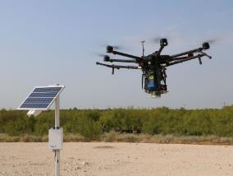
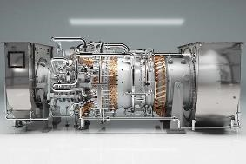
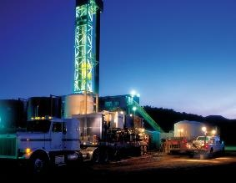
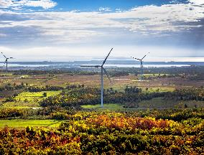
Leading the energy transition
Low carbon energy solutions
We have committed to achieve net-zero carbon eq. emissions by 2050, and invest in new technologies to help customers reduce their emissions.
Reduce flaring, venting, and fugitive emissions
Efficient power generation
Efficient oilfield
Renewables and alternative energy
Notes:
Our approach to low carbon energy has three parts.
Reduce emissions from our own operations. We have publicly committed to reduce carbon equivalent emissions by 50% by 2030 and to achieve net zero equivalent emissions by 2050 to align with the Paris Climate Agreement. Over the last 7 years we have reduced our carbon equivalent emissions by 34%, demonstrating our commitment and giving us a chance to build our in-house knowledge and expertise in low carbon energy.
Put our existing technology to work today helping the industry take immediate action to control and reduce emissions. We are actively engaged in low carbon projects with many major multinationals and national oil companies today with more on the horizon.
Invest in the development of new technology that will secure our leadership position in low carbon energy technology. This will come through a combination of in-house research and development, partnerships and new ventures.

Slide 9





Corporate responsibility
People
We value an inclusive culture that supports people and communities
Planet
We reduce our own carbon footprint + help to our customers reduce theirs
Principles
We seek to do the right thing always
“We hold ourselves accountable to do the right thing, always. Our commitments, activities, and investments are prioritized around People, Planet, and Principles.”
-Lorenzo Simonelli, Chairman and Chief Executive Officer
Carbon Disclosure Project
Barron’s 100 Most Sustainable Companies
Center for Offshore Safety Leadership Award
Morgan Stanley Capital International ESG Survey
Wall Street Journal’s Management Top 250
Notes:
We seek to operate responsibly and deliver positive outcomes for people and the planet. We look at our contribution to society in terms of people, planet and principles.
We value an inclusive culture that supports people and communities. Our global workforce is made up of 17% Women, and 35% Minority U.S. employees.
We reduce our own carbon footprint + help to reduce our customers’ carbon footprint. We have achieved a 34% Emission reduction since 2012, and have a 10 years track record of carbon transparency + emissions reductions
We seek to do the right thing always, and to protect the safety and health of our employees and the communities where we operate. We achieved 153 Perfect HSE Days in 2018 (20% increase over 2017), and have been honored with more than 55 Industry HSE awards
Some other important awards we’ve received include the
-Barron’s 100 Most Sustainable Companies – the only oil & gas company listed
-Center for Offshore Safety Leadership Award – 3 of the last 4 years
-Wall Street Journal’s Management Top 250 – the highest rating in our industry

Slide 10

Our values
Grow See challenge as opportunity, and learn every day.
Collaborate Inspire, be inclusive, and bring out the best in each other.
Lead Make, invent, and perform with impact.
Care Do the right thing, always, for our customers, our people, and the environment.
10
Notes:
As the new Baker Hughes, we are redefining the way we talk about culture. These values are how we show up every day – what we believe in and how we activate our purpose.
Grow: See challenge as opportunity, and learn every day.
Collaborate: Inspire, be inclusive, and bring out the best in each other.
Lead: Make, invent, and perform with impact.
Care: Do the right thing, always, for our customers, our people, and the environment.

Slide 11
Follow our journey
bakerhughes.com
@bakerhughesco
@bakerhughesco
Baker Hughes

Slide 12
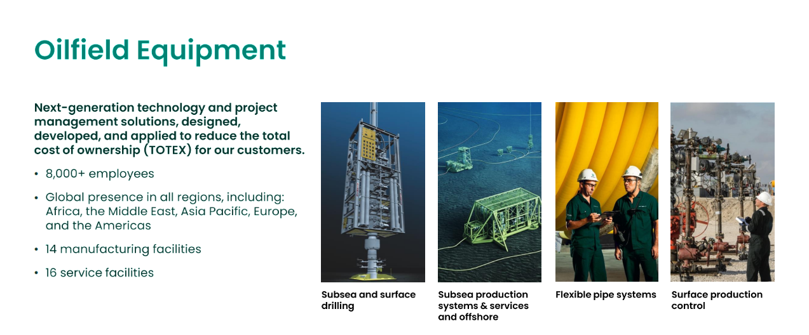
SPS

Slide 13
Intro to SPS

Slide 14
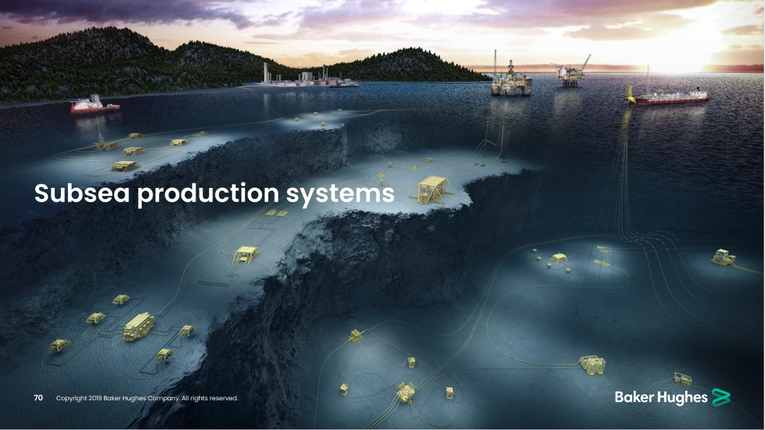

Slide 15
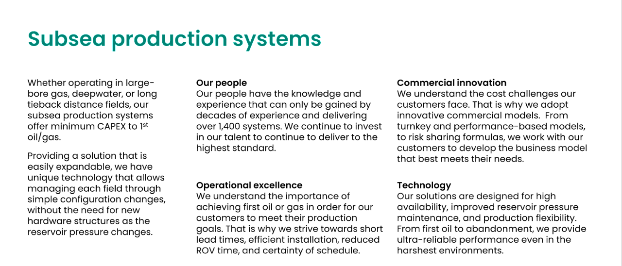

Slide 16
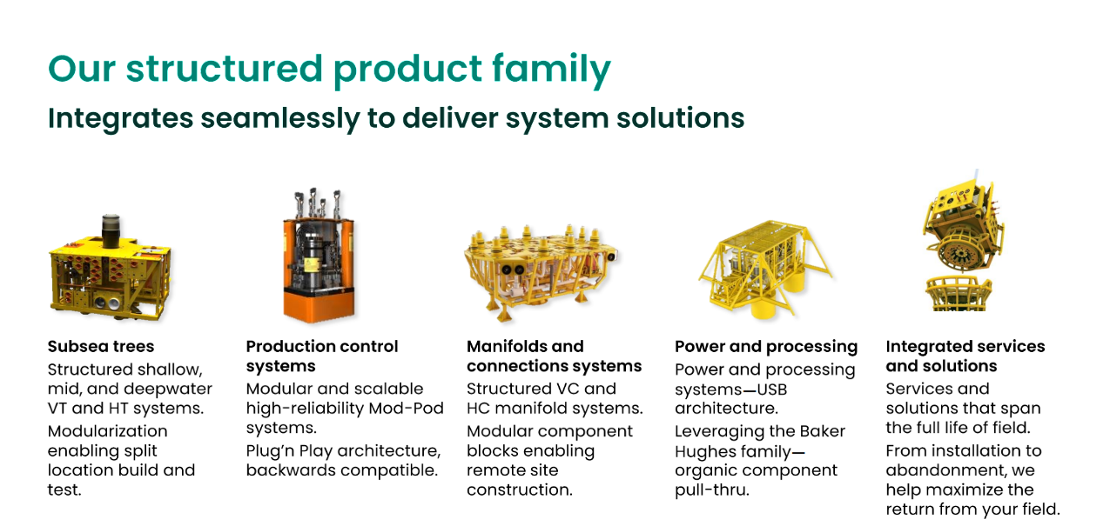

Slide 17
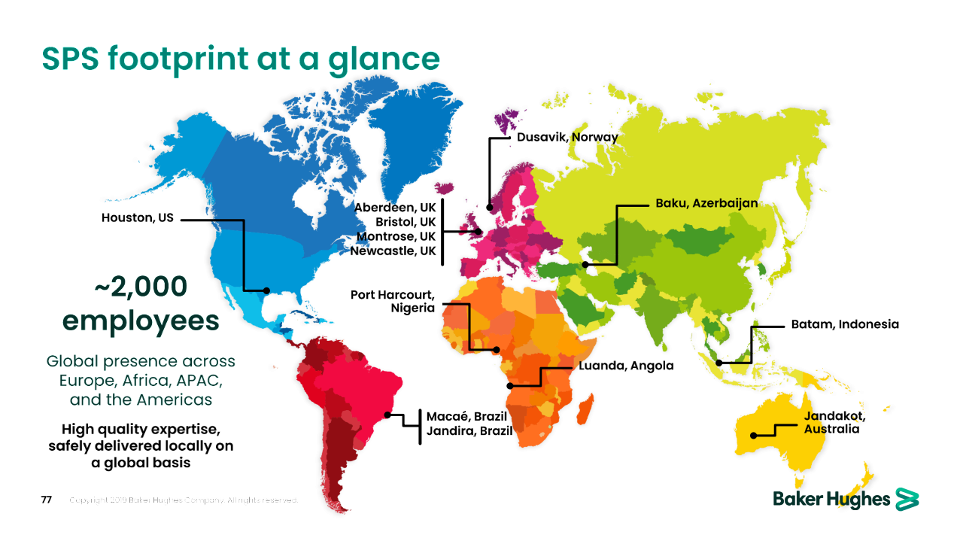

Slide 18
Baker Hughes Challenge Activity Durations in EPC Projects

Slide 19
Challenge: Analyse Activity Durations in EPC Projects
EPC Projects
SPS – Subsea Production Systems – delivers EPC Projects (Engineering + Procurement + Construction) for Oil Majors and National Oil Companies
These projects are managed through Primavera P6 and are made of multiple schedules, each with hundreds of Activities
Activity Durations are baselined, but there is variance vs Actual Durations that we would like to assess and potentially to minimise
What we would like to know
As a business, we would like you to help us understand our Activity Duration Variance based on the data provided.
Note that our interest here is not on the delay to start Activities but on the Start to Finish Durations
Description of Data provided
In the attached CSV file, each of the 95,995 lines corresponds to one activity out of 111 Active Primavera P6 Schedules of our SPS business
Data is pseudonymised to protect BH’s IP:
Schedules (Projects) numbered 1-111
Product Lines numbered 1-4
Activity Status: Not Started / Completed / In Progress
Departments numbered 1-9
Activity Types numbered 1-52
Codes with x.x.x.x.x…x hierarchical structure to refer to our product make-up and other considerations
Activity “Class” 1 or 2
Baseline Start & Finish dates & Duration in days
Forecast Start & Finish dates & Duration in days
Note: In Completed Activities, Forecast = Actual
Please note that all data, documents and submissions are for the purposes of the hackathon only, please do not copy, distribute or reproduce for any purpose without prior approval from the Author
Notes:
Divider lines are a device that can be used where necessary throughout any presentation
2- and 4-column versions of this layout are available as additional options

